Slide 1
TASK 2) IPL ANALYSIS
- BY PUBALI MONDAL

Slide 2
INTRODUCTION
HELLO I AM PUBALI MONDAL A COMPUTER science engineering student,
Here is a small ppt regarding analysis on ipl dataset
First I have taken a dataset (the dataset contains 4 csv files)
I cleaned the data using power query editor and created a power bi dashboard and done data visualizations

Slide 3
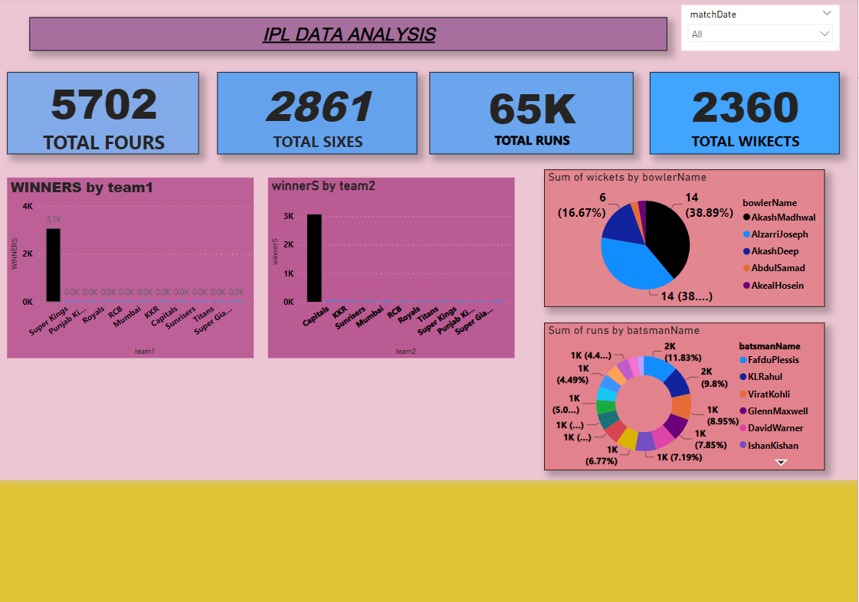
My power bi dashboard

